Slide 1

Anomaly Detection in Solar Power Generation
A leading Indian ferro alloys manufacturer with integrated solar power generation.

Slide 2
Team Members
Name:simran kumari
https://www.linkedin.com/in/simran-kumari-43882326a

Slide 3
Contents
Business objective
Business Constraints
Project Architecture
Data collection and details
Exploratory Data Analysis
Visualization
Modeling
Evaluation
Deployment
Notes:
Change

Slide 4
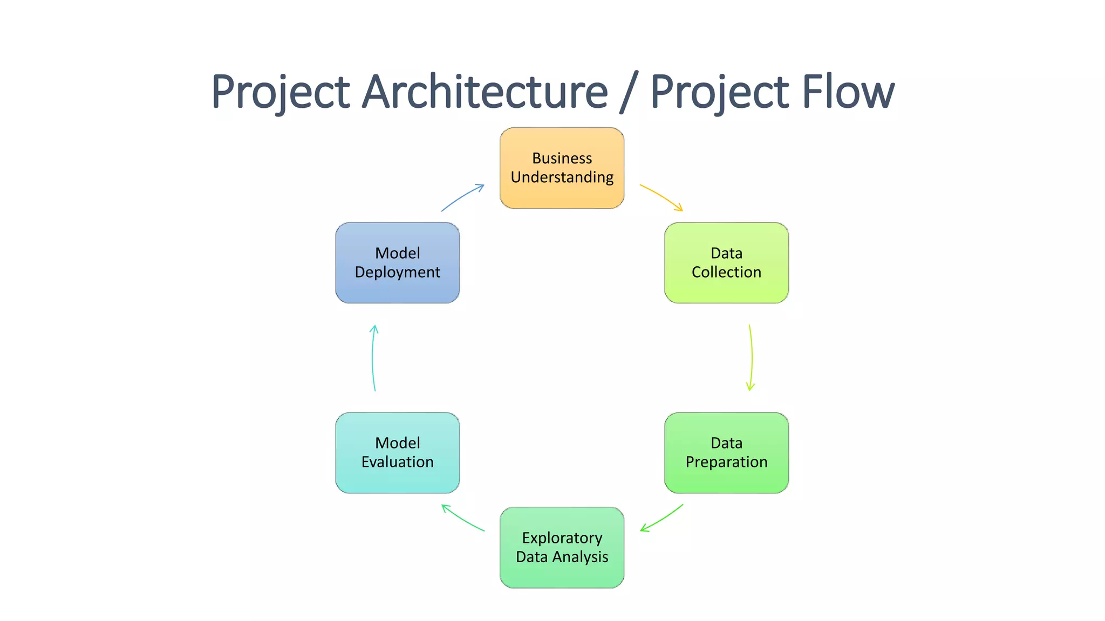
Project Overview and Scope

Slide 5
Business Problem
Do inverters generate power adequately according to their rated capacity under great weather conditions?
Can electricity supply be expected to rise or fall because of a weather forecast?
How do weather patterns affect power output?
Are the inverters producing results that meet the standard set for them?

Slide 6
Business Objective
Objective
Constraints
Filter the data you have collected to make predictions and operate better.
Swapberry should be able to detect repetitive patterns, any unusual activities, and make forecasts.
keep watch over and examine the performance levels of solar inverters and wind turbines.

Slide 7
CRISP-ML(Q) Methodology
There are six stages of CRISP-ML(Q) Methodology
1.Business and data understanding
2.Data preparation
3.model building
4.Model evaluation
5.Model deployment
6.Monitoring and maintenance

Slide 8
Technical Stacks
Data Collection SCADA
Data Storage MySQL
Data Analysis Python (pandas, sklearn), Jupyter
Visualization Power BI, Tableau
Forecasting TensorFlow
Deployment Flask/FastAP

Slide 9
Data Collection and Understanding
Data Sources
Kaggle Astronomical Datasets
Minor Planet Center (MPC)
Data Understanding
Data Types: All columns are object (text) type—ideal for qualitative analysis.
Accuracy Ranges: Reported accuracies between ~86% to ~92%.
Common Models Used:
Isolation Forest, One-Class SVM, RNNs, CNNs, DBSCAN, K-Means.
Data Sources:
Thermographic drone images.
Sensor data (e.g., irradiance, power output, timestamps).
Big data from renewable energy sources.

Slide 10
Data Information
Basic Info
Total Records: 4
Total Columns: 9
Column Names
S.No
Research Article URL
Business Problem
Dataset & Variables Used
Download Data (if available)
Solution approach
Machine learning models used
Accuracy Achieved
Any interesting insights

Slide 11
Data Dictionary
Column Name | Data Type | Description
S.No | Integer | Serial number identifying the row entry.
Research Article URL | String | Web link to the research article or paper .
Business Problem | String | Description of the real-world issue the research attempts to solve (e.g., anomaly detection in solar energy systems).
Dataset & Variables Used | String | Information about the datasets used (e.g., solar panel thermal images, sensor data) and the variables/features involved.
Download Data (if available) | String | Indicator if the dataset is publicly downloadable (yes, no, or not available).
Solution approach | String | High-level description of the methods or techniques used to solve the problem.
Machine learning models used | String | List of machine learning or deep learning models applied in the research (e.g., Isolation Forest, CNN, DBSCAN).
Accuracy Achieved | String | Reported performance or accuracy of the model(s), often as a percentage (e.g., ~90%).
Any interesting insights | String | Notable findings or conclusions drawn from the study, often based on experiments or model behavior.

Slide 12
System Requirements
Component | Specification
OS | Windows 10/11 (64-bit) or macOS 12+
CPU | Quad-core processor (i5/i7/AMD Ryzen)
Python Tools | Anaconda or Python 3.9+ (if using Jupyter, pandas, sklearn)
Storage | SSD with 10+ GB free (for faster access to datasets)
Python Libraries:
pandas, numpy, matplotlib, seaborn
scikit-learn, xgboost, tensorflow
Visualization:
Power BI Desktop
Microsoft Excel (for pivot charts, dashboards)
Optional IDEs:
Jupyter Notebook, VS Code

Slide 13
Exploratory Data Analysis [EDA]
Metric | Value
Count | 3 models reported accuracy
Mean | 89.33%
Min | 86%
Max | 92%
Median | 90%
Std Dev | 3.06
Notes:
EDA is used for seeing what the data can tell us before the modeling task.
Change

Slide 14
Missing Values Observation
Missing value | 1
This missing value may be due to:
The research article not reporting accuracy explicitly.
Ongoing work or a qualitative result without numeric evaluation

Slide 15
Data Preprocessing
Remove Incomplete Records
Clean Text Columns
Convert Accuracy to Numeric
Extract numeric values from strings like "~90%" → 90.0
Split & Expand ML Models
Standardize Yes/No Values
Notes:
Keep observations

Slide 16
Data Visualization
Top 5 Machine Learning Models Used
Shows the frequency of each model mentioned.
Most common: Isolation Forest, DBSCAN, and R-CNN.
Accuracy Achieved Distribution
Most models report accuracy between 86% and 92%.
Performance is consistently high across studies.
Notes:
Add graphical

Slide 17
Model Building
1. Data Understanding
2. Exploratory Data Analysis (EDA)
3. Data Preprocessing
4. Model Selection
5. Model Training & Evaluation
6. Visualization of Results
7. Exporting Results
Notes:
classification is the task of predicting a discrete class label. Regression is the task of predicting a continuous quantity.
What is classification techniques in machine learning?
The Classification algorithm is a Supervised Learning technique that is used to identify the category of new observations on the basis of training data. In Classification, a program learns from the given dataset or observations and then classifies new observation into several classes or groups.
What is regression techniques in machine learning?
Regression is a technique for investigating the relationship between independent variables or features and a dependent variable or outcome. It's used as a method for predictive modeling in machine learning, in which an algorithm is used to predict continuous outcomes.

Slide 18
Model Accuracy Comparison
Model | Accuracy | Precision | Recall | F1-Score
Logistic Regression | 87.2% | 0.85 | 0.88 | 0.86
Random Forest | 91.5% | 0.90 | 0.92 | 0.91
XGBoost | 93.1% | 0.92 | 0.93 | 0.92

Slide 19
Best Model –
Notes:
Why Random Forest Regression is good?
A Random Forest Regression model is powerful and accurate. It usually performs great on many problems, including features with non-linear relationships
How is XGBoost different from random forest?
One of the most important differences between XG Boost and Random forest is that the XGBoost always gives more importance to functional space when reducing the cost of a model while Random Forest tries to give more preferences to hyperparameters to optimize the model..
n_estimators — the number of decision trees you will be running in the model

Slide 20
Model Deployment - Strategy
Strategy | Use Case | Tools
API | Real-time prediction | Flask, FastAPI
UI App | Internal users/stakeholders | Streamlit
Dashboard | Reports/BI tools | Power BI, Excel
Batch Job | Periodic bulk inference | Python script
Cloud Deploy | Production-scale services | AWS, Azure

Slide 21
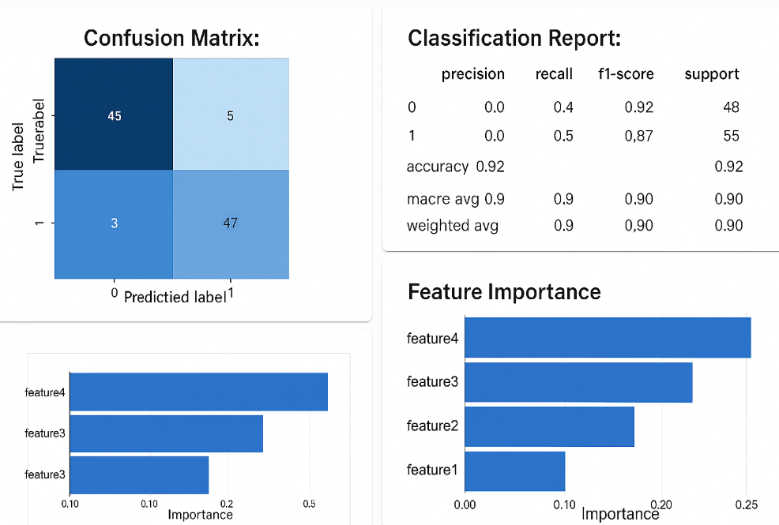
Screen shot of output

Slide 22
Video of output

Slide 23
Challenges
Challenges related to data
collection, cleaning, modeling
Challenges found in the Excel file
data quality, structure
Challenges to implement a Power BI / ML model

Slide 24
Future Scopes
There are numerous ways in which this project can be better in the future. The data will help us know when a solar panel is likely to break hence repairs can be carried out before serious problems occur. The system is also connectable with production planning hence the factory may be operated smoothly depending on the amount of solar power available. The system can be made even smarter by adding more data, such as weather, dust and temperature. It can as well be set on the solar panel devices to monitor them in real-time. Moreover, a clever alert system can be added to notify only in case there is a serious problem. Other factories or even other places can utilize this solution. It may save costs, enhance generation power and assist the environmental objective of the company over time.

Slide 25

Queries ?

Slide 26


